Slide 1
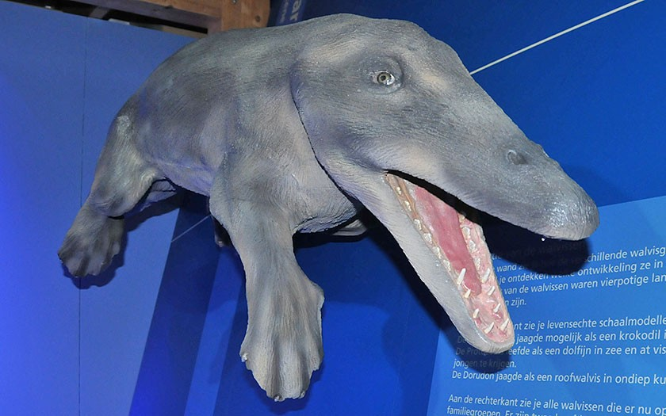
Notes:
In the early Tertiary (around 50 million years ago), a group of predator-like mammals inhabited the coastal regions. Eventually, they adapted more and more to an aquatic life in the sea.

Slide 2
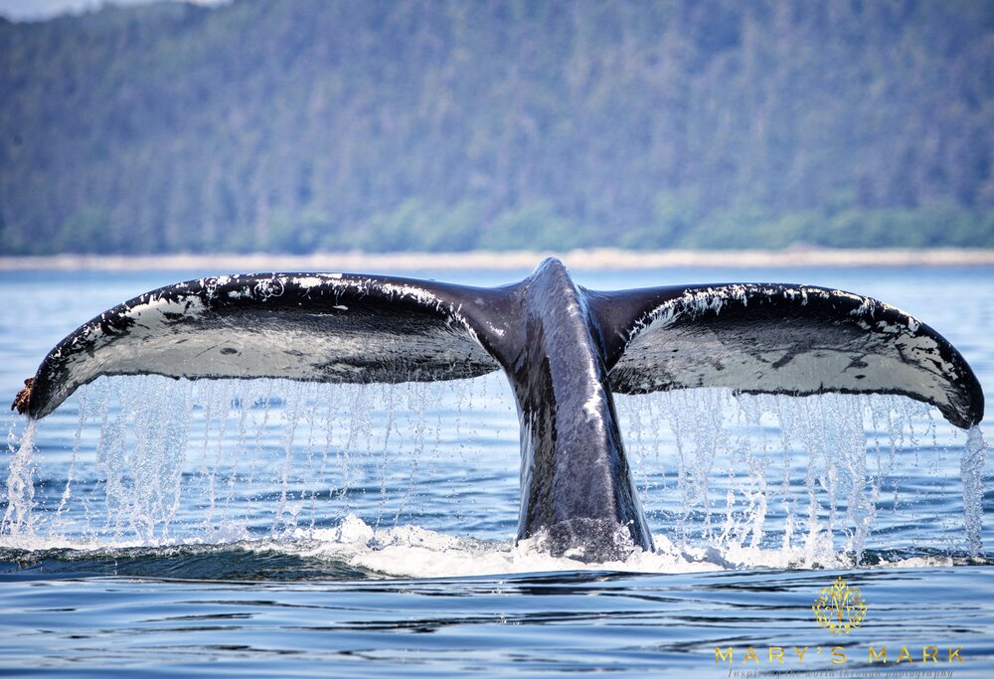
Notes:
What can you tell me about whales?

Slide 3
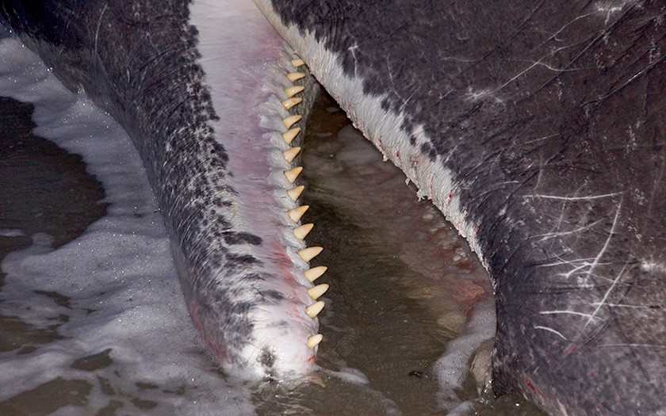
Notes:
Toothed whales are generally much smaller than baleen whales. Only sperm whales are comparable in length with baleen whales. Dolphins and porpoises are also toothed whales. They eat primarily fish or squid. The killer whale also hunts seals, penguins, sharks, porpoises and dolphins.

Slide 4
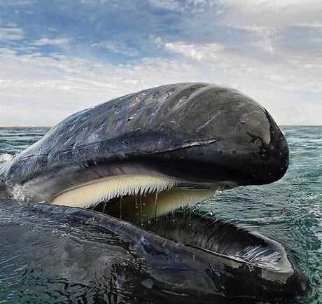
Notes:
Most baleen whales are gigantic. They have an enormous toothless mouth. Instead of teeth they have baleen plates, which are made from horn-like material and hang in rows in the palate of the upper jaw. The whales use these baleen plates to filter out their food. Most of these whales live off of krill: shrimp-like animals found in plentiful amounts in the open sea. They will also consume small fish such as herring.

Slide 5
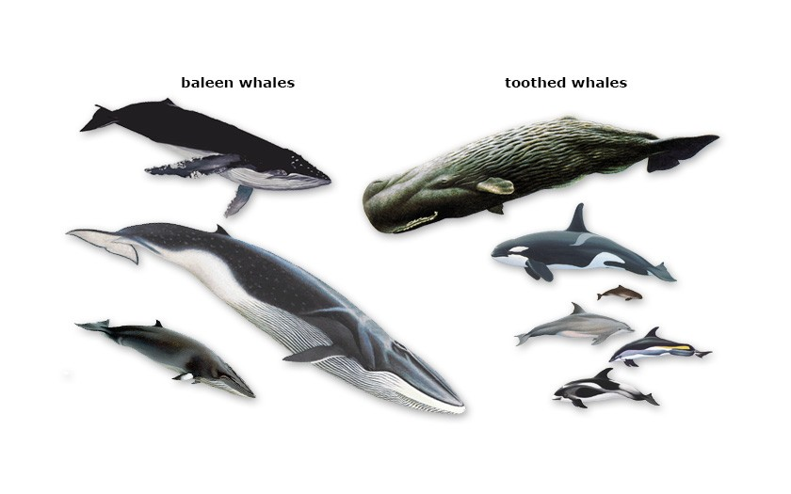

Slide 6
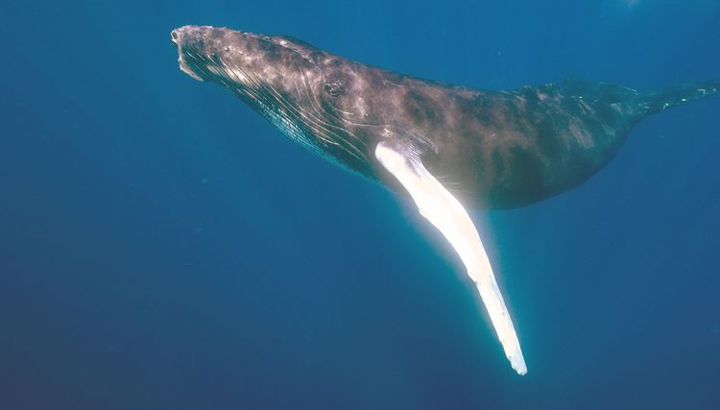
Notes:
There are three species of baleen whale which have pregnancies that last 11-12 months. Sperm whales typically gestate for 15 months. In general, most cetaceans have 10-13 month pregnancies,
with some species of whales like pilot whales and orcas having 16-17 month pregnancies.

Slide 7
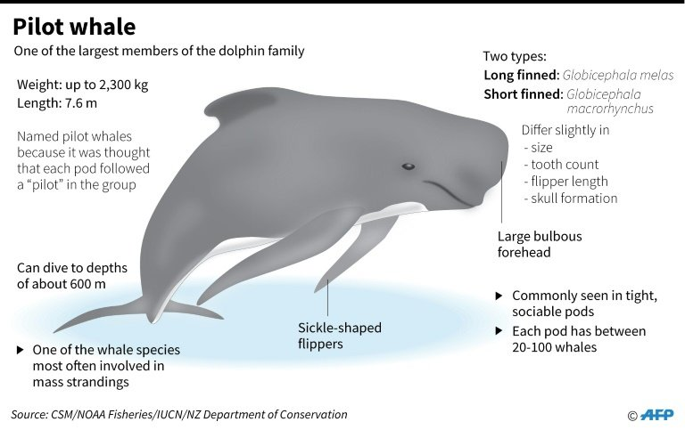
Notes:
Births tend to happen every 3-5 years. Twins are rare. The number of calves a female has over its lifetime depends on the species.
Calves are born tail first. This gives the flukes a chance to unfold, ensures that the blowholes are exposed to the water late in the delivery and that the heaviest part of the calf doesn’t come out first, and thus direct the newborn downward away from the mother.

Slide 8
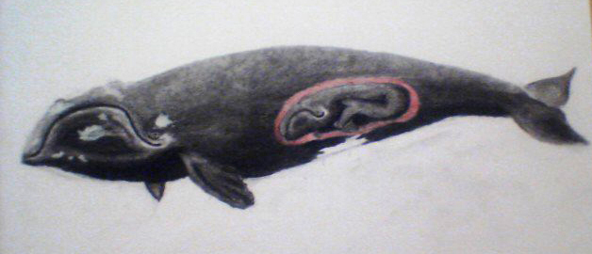
Notes:
Some whales nurse for 6-7 months while others nurse for two years.
juveniles as old as 13 have been found with milk in their stomachs, but are also eating prey.

