Slide 1
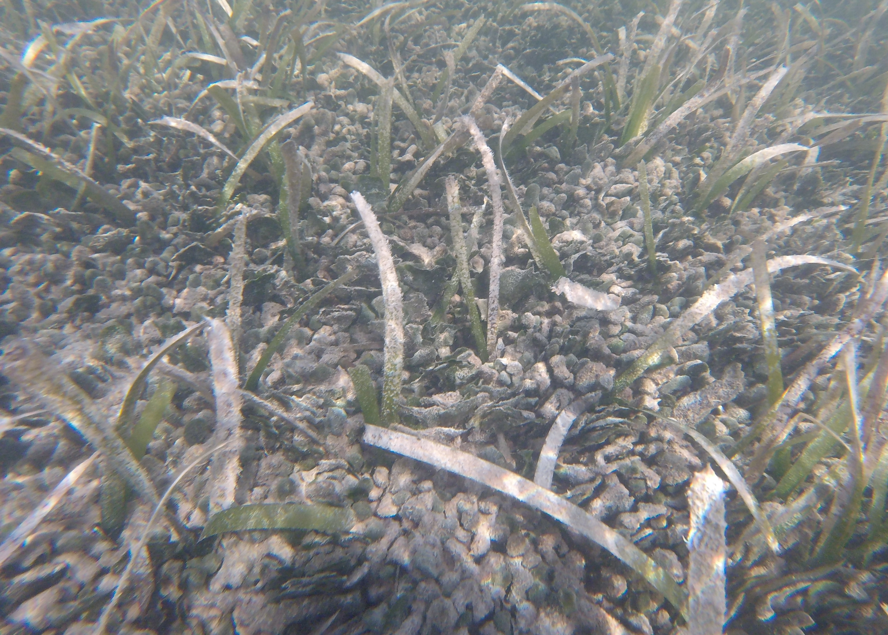
Avrainvillea at Lac Bay
Thijs Hofstede
Radboud University Nijmegen

Slide 2
Introduction
Biomass
Carbon uptake stored in the sediment
Hardly degradable organic sediment
Carbon sink
Increasing
Lac Bay more nutrient rich + sargassum influx
Competitive advantage due to nutrient loading (displaced Hawaii local seagrass)
Thalassia long healthy leaves with few epiphytes
However, density seems less

Slide 3
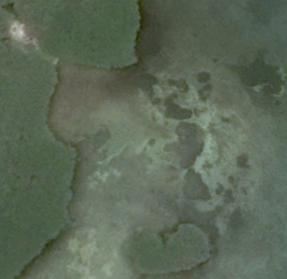
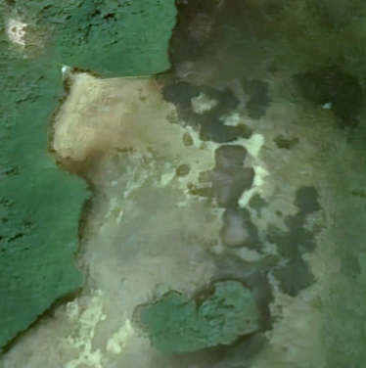
Introduction
2016
2021

Slide 4
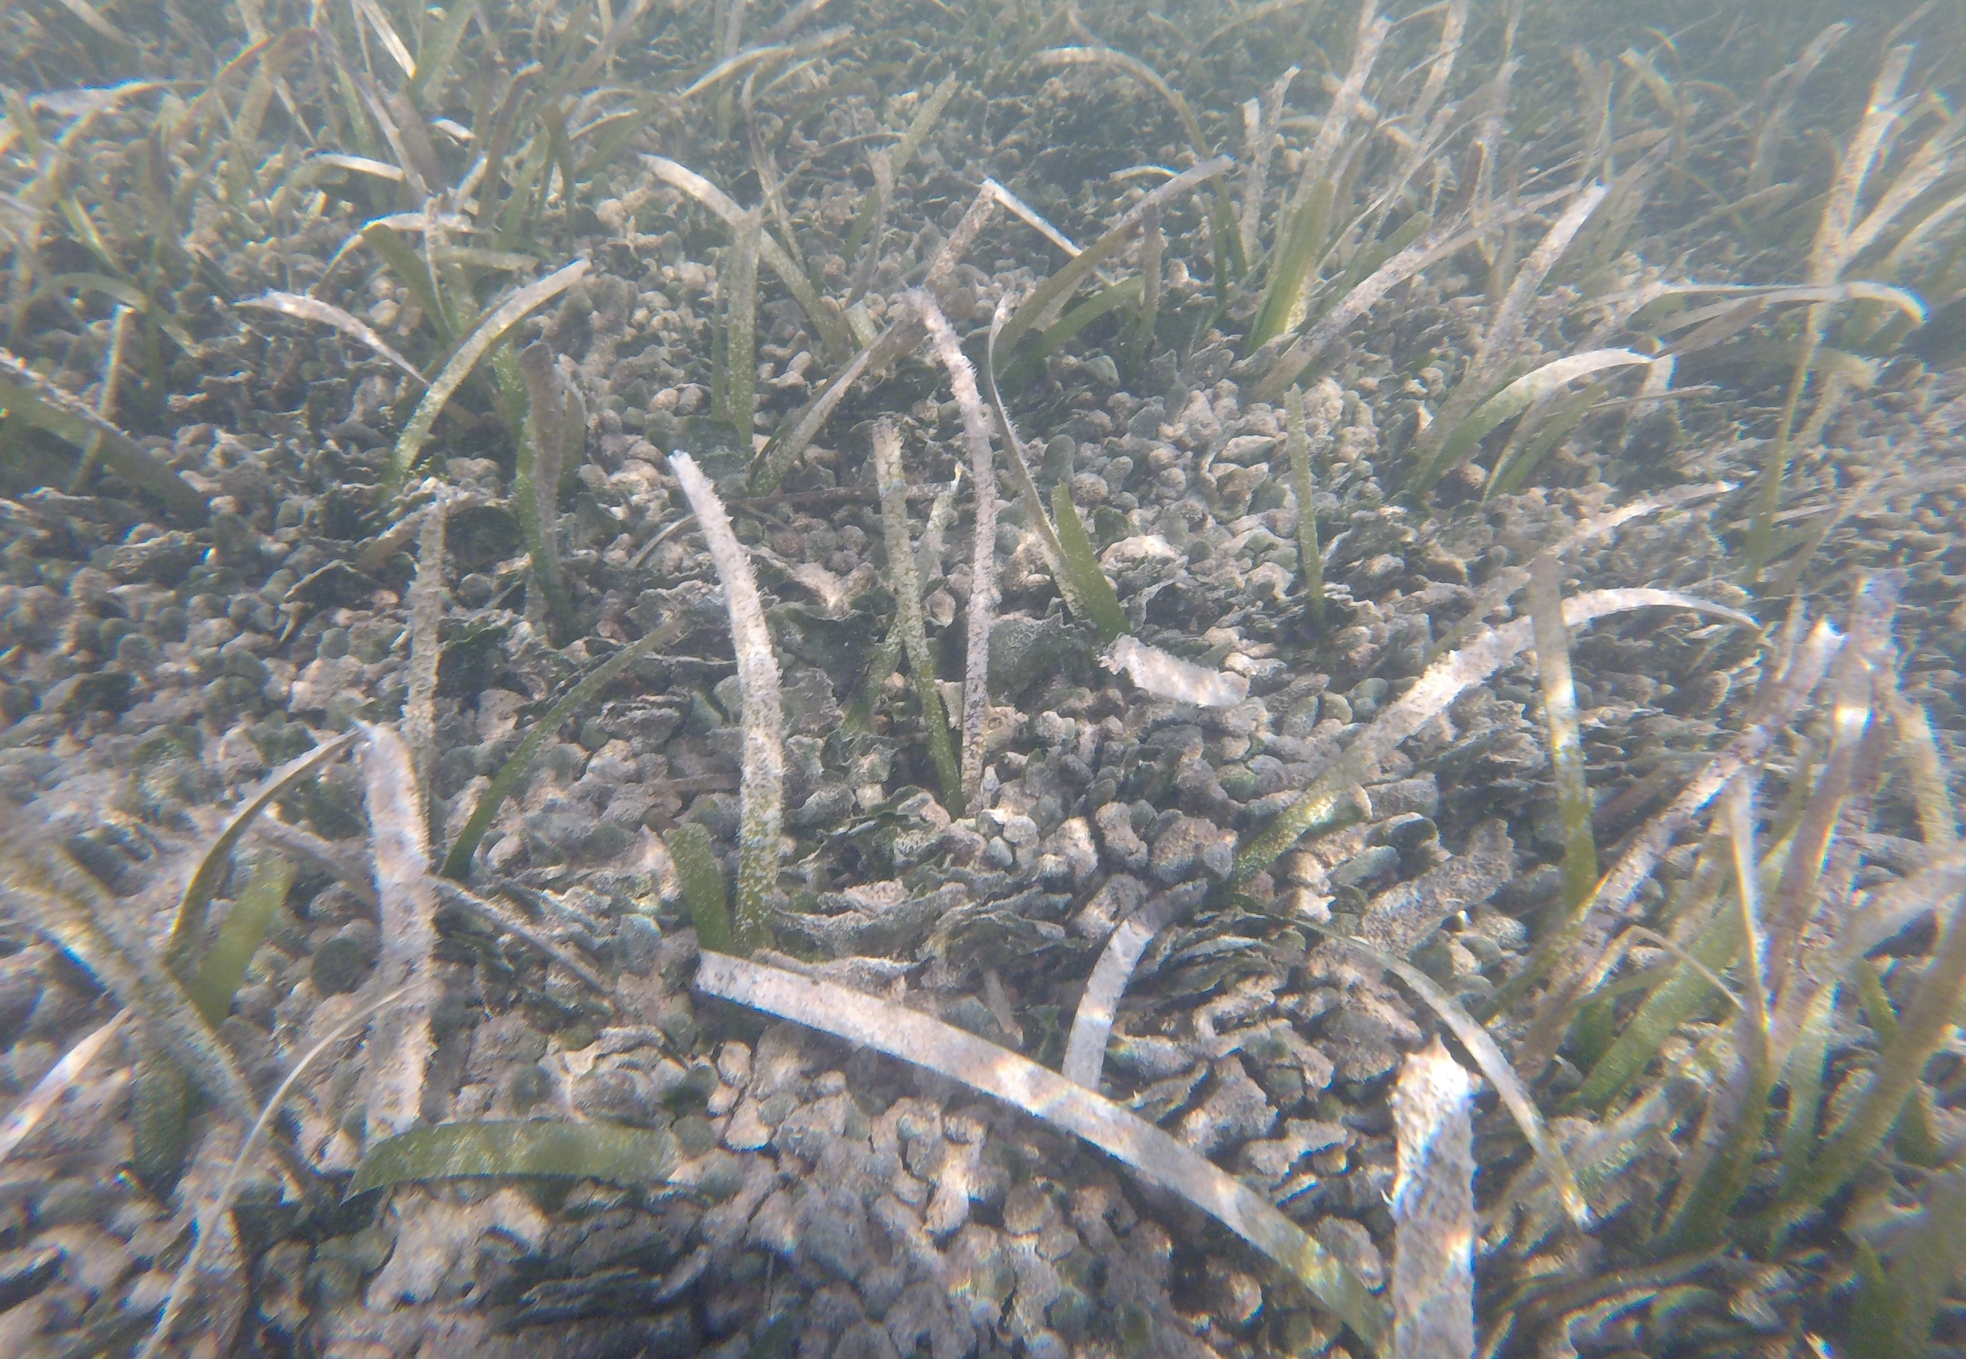
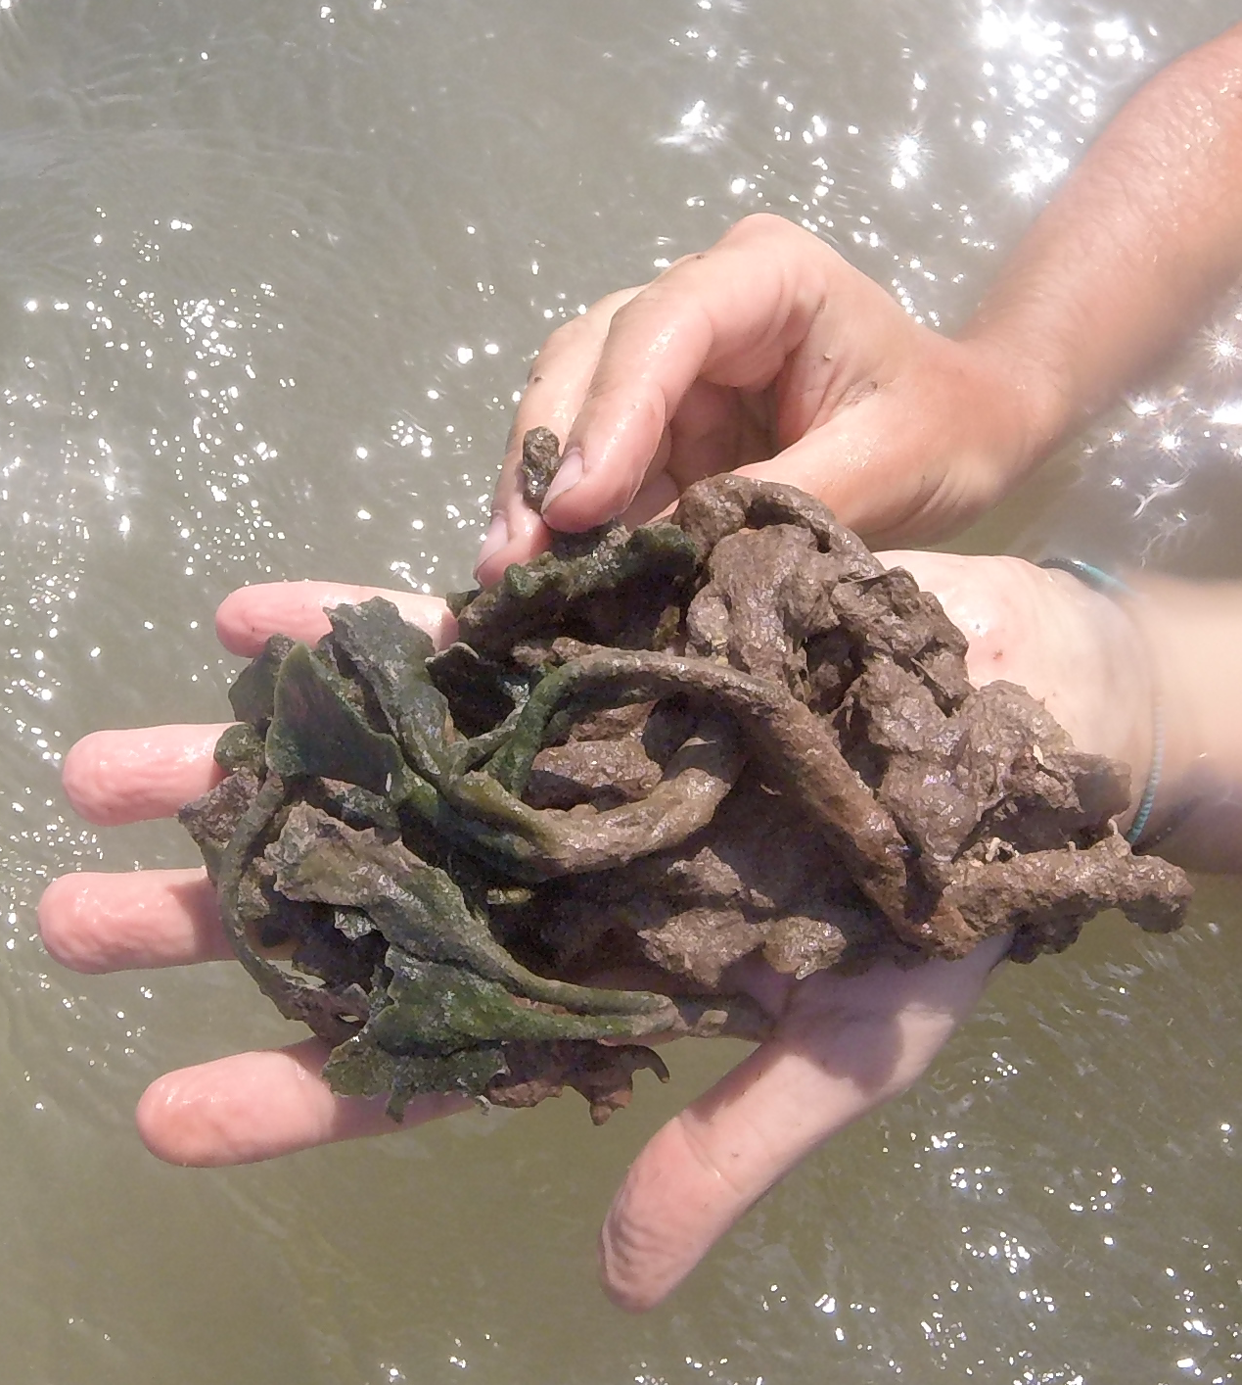
Introduction
Different forms
Long healthy Thalassia, lower density
Attached in the sediment

Slide 5
Monitoring current situation
Yellow line = 2016 or older
White line = after 2016
2016
2021
Category 1 = youngest
Category 2 = middle
Category 3 = oldest
Category 4 = Thalassia patch without Avrainvillea
Thalassia cover, biomass, and traits
Nutrient composition
Long term biomass production Avrainvillea

Slide 6
Regrowth experiment
Biomass
Horizontal growth
Vertical growth

Slide 7
Avrainvilea Sargassum-run off interaction effect on Thalassia
Effect of Sargassum run off
Thalassia traits
More or less epiphytes?
Different leaf traits?
Nutrients and sulphide
Difference in nutrient concentration?
Difference in Sulphide concentration?

Slide 8
Sargassum addition experiment
Effect of direct Sargassum
Thalassia traits
More or less epiphytes?
Different leaf traits?
Nutrients and sulphide
Difference in nutrient concentration?
Difference in Sulphide concentration?

Slide 9
Wrap up
Monitor
Long term biomass production
Interaction with Thalassia
Sediment layer + nutrients
Regrowth
Short term biomass production
Interaction effect Sargassum + Avrainvillea on Thalassia
Thalassia traits
Nutrients

